Slide 1


The Blockchain Game
This work is licensed under a Creative Commons Attribution-NonCommercial-ShareAlike 4.0 International License.
J Scott Christianson
Notes:
REMEMBER TO LOAD OTHER SITES AND FILES!

Slide 2
Blockchain Basics
The Blockchain Game
A Distributed Ledger
  No central server or authority.
  Everyone (aka node) on the network has a copy of the ledger.
  A huge variety of information can be stored on a blockchain ledger.
Notes:
Today we are going to b e

Slide 3
Blockchain Basics
The Blockchain Game
A Distributed Ledger Can Store:
  Financial Transactions
  Property Records
  Shipments and Inventory
  Grades????
Notes:
Anonymous (for Grades)

Slide 4
Blockchain Basics
The Blockchain Game
A Distributed Ledger For Grades
  All teachers calculate student grades and then enter the grades into a central repository (the registrar or central office ).
  Why not eliminate the registrar (save some $$) and just have the teachers maintain the ledger of grades?

Slide 5
The Grade Blockchain
The Blockchain Game
Let’s try it!
  Everyone in the class will act as “special” nodes called “Miners.”
  I will pick on seven people to be “students”
Notes:
-Distribute Ledger
Hand out all the stuff to the miners and the nodes

Slide 6
The Grade Blockchain
The Blockchain Game
Student identities are concealed.
    Each student has a public ID that matches with a private ID that only the student knows.
Notes:
-Distribute Ledger
-Distribute Student Key Pairs

Slide 7
Student
1
Below is your key pair for the grade blockchain. Your teacher will assign a grade to your public key. You can then use any of the grade scanning tools to review the blockchain and retrieve your grades.
Public Key | Private Key
ad59da | c8fc47b6fe
Notes:
Student 1
Public Key: ad59da
Private Key: c8fc47b6fe
Student 2
Public Key: bd9ebc
Private Key: 4382af3398
Student 3
Public Key: da603d
Private Key: 187235b94a
Student 4
Public Key: fc45e2
Private Key: 39c2ef1cb6
Student 5
Public Key: c67445
Private Key: 56164d905c
Student 6
Public Key: bde7af
Private Key: f674f230d4
Student 7
Public Key: e2dd8a
Private Key: ae4710fff0

Slide 8
Block 1
The Blockchain Game
Course:
Student:
Grade:
Parks 320
ad59da
F
Notes:
-Distribute Ledger
-Distribute Student Key Pairs
—-then hash
—-then voting

Slide 9
Our First Block
The Blockchain Game
Grade BlockChain
Block | Course | Student | Grade | Nonce (1-3) | a | b | c | Value of Last 2 digits of Prev Hash | Hash
 |  |  |  |  |  |  |  |  | 212
1 | Parks 320 | ad59da | F |  |  |  |  | 12
2
3
4
5
6
Notes:
-Distribute Ledger
-Distribute Student Key Pairs
—-then hash
—-then voting

Slide 10
Finishing the block: Hashing
The Blockchain Game
Miners will solve a puzzle to create a unique number for the block (aka a hash) using the information contained in our block and use that to make our ledger secure!
First to generate a correct hash wins
Other miners and nodes will verify if that hash is correct
Notes:
-Distribute Ledger
-Distribute Student Key Pairs
—-then hash
—-then voting

Slide 11

Miners Mine!!
Hash = Nonce + a + b + c - Value of Last 2 digits of prev Hash
Table
a = Value of the first letter of the course
b = Value of the first letter of the student Public Key
c = Value of the Grade
A | 65
B | 66
C | 67
D | 68
E | 69
F | 70
G | 71
H | 72
I | 73
J | 74
K | 75
L | 76
M | 77
N | 78
O | 79
P | 80
Q | 81
R | 82
S | 83
T | 84
U | 85
V | 86
W | 87
X | 88
Y | 89
Z | 90
Nonce =
value between 1 and 3 that you will adjust to calculate a hash that can be equally divisible by 3

Slide 12
Miners Mine!!
Hash = Nonce + a + b + c - Value of Last 2 digits of prev Hash
a = Value of the first letter of the course in the look up table (a=65, b=66, etc.)
b = Value of the first letter of the student Public Key in the look up table (a=65, b=66, etc.)
c = Value of the Grade in the look up table (a=65, b=66, etc.)
Look up Table
A | 65
B | 66
C | 67
D | 68
E | 69
F | 70
G | 71
H | 72
I | 73
J | 74
K | 75
L | 76
M | 77
N | 78
O | 79
P | 80
Q | 81
R | 82
S | 83
T | 84
U | 85
V | 86
W | 87
X | 88
Y | 89
Z | 90
Nonce =
value between 1 and 3 that you will adjust to calculate a hash that can be equally divisible by 3

Slide 13
Miners Mine!!
Hash = Nonce + a + b + c - Value of Last 2 digits of prev Hash
a = Value of the first letter of the course in the look up table (a=65, b=66, etc.)
b = Value of the first letter of the student Public Key in the look up table (a=65, b=66, etc.)
c = Value of the Grade in the look up table (a=65, b=66, etc.)
Look up Table
A | 65
B | 66
C | 67
D | 68
E | 69
F | 70
G | 71
H | 72
I | 73
J | 74
K | 75
L | 76
M | 77
N | 78
O | 79
P | 80
Q | 81
R | 82
S | 83
T | 84
U | 85
V | 86
W | 87
X | 88
Y | 89
Z | 90
Nonce =
value between 1 and 3 that you will adjust to calculate a hash that can be equally divisible by 3

Slide 14
Our First Block
The Blockchain Game
Grade BlockChain
Block | Course | Student | Grade | Nonce (1-3) | a | b | c | Value of Last 2 digits of Prev Hash | Hash
 |  |  |  |  |  |  |  |  | 212
1 | Parks 320 | ad59da | F |  | 80 | 65 | 70 | 12
2
3
4
5
6
Hash = Nonce + a + b + c - Value of Last 2 digits of prev Hash
Notes:
-Distribute Ledger
-Distribute Student Key Pairs
—-then hash
—-then voting

Slide 15
Finishing the block: Hashing
The Blockchain Game
1
Grade BlockChain
Block | Course | Student | Grade | Nonce (1-3) | a | b | c | Value of Last 2 digits of Prev Hash | Hash
 |  |  |  |  |  |  |  |  | 212
1 | Parks 320 | ad59da | F | 1 | 80 | 65 | 70 | 12 | 204
2
3
4
5
6
Hash = Nonce + a + b + c - Value of Last 2 digits of prev Hash
Notes:
-Distribute Ledger
-Distribute Student Key Pairs
—-then hash
—-then voting

Slide 16
Block 2
The Blockchain Game
Course:
Student:
Grade:
Engineering 300
bd9ebc
B
Look up Table
A | 65
B | 66
C | 67
D | 68
E | 69
F | 70
G | 71
H | 72
I | 73
J | 74
K | 75
L | 76
M | 77
N | 78
O | 79
P | 80
Q | 81
R | 82
S | 83
T | 84
U | 85
V | 86
W | 87
X | 88
Y | 89
Z | 90
Miners Mine —> Verify and Vote —>
Hash = Nonce + a + b + c - Value of Last 2 digits of prev Hash
Notes:
-Distribute Ledger
-Distribute Student Key Pairs
—-then hash
—-then voting

Slide 17
Finishing the block: Hashing
The Blockchain Game
1
2
Grade BlockChain
Block | Course | Student | Grade | Nonce (1-3) | a | b | c | Value of Last 2 digits of Prev Hash | Hash
 |  |  |  |  |  |  |  |  | 212
1 | Parks 320 | ad59da | F | 1 | 80 | 65 | 70 | 12 | 204
2 | Engineering 300 | bd9ebc | B | 1 | 69 | 66 | 66 | 4 | 198
3
4
5
6
Hash = Nonce + a + b + c - Value of Last 2 digits of prev Hash
Notes:
-Distribute Ledger
-Distribute Student Key Pairs
—-then hash
—-then voting

Slide 18
Block 3
The Blockchain Game
Course:
Student:
Grade:
Business 200
c67445
C
Look up Table
A | 65
B | 66
C | 67
D | 68
E | 69
F | 70
G | 71
H | 72
I | 73
J | 74
K | 75
L | 76
M | 77
N | 78
O | 79
P | 80
Q | 81
R | 82
S | 83
T | 84
U | 85
V | 86
W | 87
X | 88
Y | 89
Z | 90
Miners Mine —> Verify and Vote —>
Hash = Nonce + a + b + c - Value of Last 2 digits of prev Hash
Notes:
-Distribute Ledger
-Distribute Student Key Pairs
—-then hash
—-then voting

Slide 19
Finishing the block: Hashing
The Blockchain Game
1
2
3
Grade BlockChain
Block | Course | Student | Grade | Nonce (1-3) | a | b | c | Value of Last 2 digits of Prev Hash | Hash
 |  |  |  |  |  |  |  |  | 212
1 | Parks 320 | ad59da | F | 1 | 80 | 65 | 70 | 12 | 204
2 | Engineering 300 | bd9ebc | B | 1 | 69 | 66 | 66 | 4 | 198
3 | Business 200 | c67445 | C | 3 | 66 | 67 | 67 | 98 | 105
4
5
6
Hash = Nonce + a + b + c - Value of Last 2 digits of prev Hash
Notes:
-Distribute Ledger
-Distribute Student Key Pairs
—-then hash
—-then voting

Slide 20
Block 4
The Blockchain Game
Course:
Student:
Grade:
Parks 320
e2dd8a
B
Look up Table
A | 65
B | 66
C | 67
D | 68
E | 69
F | 70
G | 71
H | 72
I | 73
J | 74
K | 75
L | 76
M | 77
N | 78
O | 79
P | 80
Q | 81
R | 82
S | 83
T | 84
U | 85
V | 86
W | 87
X | 88
Y | 89
Z | 90
Miners Mine —> Verify and Vote —>
Hash = Nonce + a + b + c - Value of Last 2 digits of prev Hash
Notes:
-Distribute Ledger
-Distribute Student Key Pairs
—-then hash
—-then voting

Slide 21
Finishing the block: Hashing
The Blockchain Game
1
2
3
4
Grade BlockChain
Block | Course | Student | Grade | Nonce (1-3) | a | b | c | Value of Last 2 digits of Prev Hash | Hash
 |  |  |  |  |  |  |  |  | 212
1 | Parks 320 | ad59da | F | 1 | 80 | 65 | 70 | 12 | 204
2 | Engineering 300 | bd9ebc | B | 1 | 69 | 66 | 66 | 4 | 198
3 | Business 200 | c67445 | C | 3 | 66 | 67 | 67 | 98 | 105
4 | Parks 320 | e2dd8a | B | 3 | 80 | 69 | 66 | 5 | 213
5
6
Notes:
-Distribute Ledger
-Distribute Student Key Pairs
—-then hash
—-then voting

Slide 22
Block 5
The Blockchain Game
Course:
Student:
Grade:
Engineering 300
e2dd8a
D
Look up Table
A | 65
B | 66
C | 67
D | 68
E | 69
F | 70
G | 71
H | 72
I | 73
J | 74
K | 75
L | 76
M | 77
N | 78
O | 79
P | 80
Q | 81
R | 82
S | 83
T | 84
U | 85
V | 86
W | 87
X | 88
Y | 89
Z | 90
Miners Mine —> Verify and Vote —>
Hash = Nonce + a + b + c - Value of Last 2 digits of prev Hash
Notes:
-Distribute Ledger
-Distribute Student Key Pairs
—-then hash
—-then voting

Slide 23
Finishing the block: Hashing
The Blockchain Game
1
2
3
4
5
Grade BlockChain
Block | Course | Student | Grade | Nonce (1-3) | a | b | c | Value of Last 2 digits of Prev Hash | Hash
 |  |  |  |  |  |  |  |  | 212
1 | Parks 320 | ad59da | F | 1 | 80 | 65 | 70 | 12 | 204
2 | Engineering 300 | bd9ebc | B | 1 | 69 | 66 | 66 | 4 | 198
3 | Business 200 | c67445 | C | 3 | 66 | 67 | 67 | 98 | 105
4 | Parks 320 | e2dd8a | B | 3 | 80 | 69 | 66 | 5 | 213
5 | Engineering 300 | e2dd8a | D | 2 | 69 | 69 | 68 | 13 | 195
6
Notes:
-Distribute Ledger
-Distribute Student Key Pairs
—-then hash
—-then voting

Slide 24
Block 6
The Blockchain Game
Course:
Student:
Grade:
Engineering 300
bde7af
B
Look up Table
A | 65
B | 66
C | 67
D | 68
E | 69
F | 70
G | 71
H | 72
I | 73
J | 74
K | 75
L | 76
M | 77
N | 78
O | 79
P | 80
Q | 81
R | 82
S | 83
T | 84
U | 85
V | 86
W | 87
X | 88
Y | 89
Z | 90
Miners Mine —> Verify and Vote —>
Hash = Nonce + a + b + c - Value of Last 2 digits of prev Hash
Notes:
-Distribute Ledger
-Distribute Student Key Pairs
—-then hash
—-then voting

Slide 25
Finishing the block: Hashing
The Blockchain Game
1
2
3
4
5
6
Grade BlockChain
Block | Course | Student | Grade | Nonce (1-3) | a | b | c | Value of Last 2 digits of Prev Hash | Hash
 |  |  |  |  |  |  |  |  | 212
1 | Parks 320 | ad59da | F | 1 | 80 | 65 | 70 | 12 | 204
2 | Engineering 300 | bd9ebc | B | 1 | 69 | 66 | 66 | 4 | 198
3 | Business 200 | c67445 | C | 3 | 66 | 67 | 67 | 98 | 105
4 | Parks 320 | e2dd8a | B | 3 | 80 | 69 | 66 | 5 | 213
5 | Engineering 300 | e2dd8a | D | 2 | 69 | 69 | 68 | 13 | 195
6 | Engineering 300 | bde7af | B | 2 | 69 | 66 | 66 | 95 | 108
Notes:
-Distribute Ledger
-Distribute Student Key Pairs
—-then hash
—-then voting

Slide 26
Questions?
The Blockchain Game
Anyone, what courses did c67445 take and what grade did they earn?
Student 2 what grades have you received?
Notes:
delete a student key

Slide 27
What if….
The Blockchain Game
We change block 1
Notes:
delete a student key

Slide 28
Block 1
The Blockchain Game
Course:
Student:
Grade:
Parks 320
ad59da
F -> A
Notes:
Demonstrate with the spreadsheet
Changing one block will make all following blocks invalid

Slide 29
What if….
The Blockchain Game
A grade is announced by someone other than a faculty member?
Student pays off a node (any node) to record an A in for their grade?
Student 5’s Private Key is lost.
Notes:
51% Attack

Slide 30
Finishing the block: Hashing
The Blockchain Game
1
2
3
4
5
6
Grade BlockChain
Block | Course | Student | Grade | Nonce (1-6) | a | b | c | Value of Last 2 digits of Prev Hash | Hash
 |  |  |  |  |  |  |  |  | 212
1 | Parks 320 | ad59da | F | 1 | 80 | 65 | 70 | 12 | 204
2 | Engineering 300 | bd9ebc | B | 1 | 69 | 66 | 66 | 4 | 198
3 | Business 200 | c67445 | C | 3 | 66 | 67 | 67 | 98 | 105
4 | Parks 320 | e2dd8a | B | 3 | 80 | 69 | 66 | 5 | 213
5 | Engineering 300 | e2dd8a | D | 2 | 69 | 69 | 68 | 13 | 195
6 | Engineering 300 | bde7af | B | 2 | 69 | 66 | 66 | 95 | 108
Notes:
-Distribute Ledger
-Distribute Student Key Pairs
—-then hash
—-then voting

Slide 31
What if….
The Blockchain Game
A miner changes a transaction and announces the hash to the network before anyone else calculates it?
The difficulty of calculating a hash increases as the blockchain grows?

Slide 32
What did we observe in this “Game”
Distributed Ledger
  No central authority to hold ledger or be attacked.
  All people (aka nodes) have complete ledger.
Transparent but anonymous Ledger
  Ledger can be public while concealing identity.
Append only Ledger
  Each entry (aka block) is linked to the previous entry via some math (aka hash).
  Some nodes (aka miners) are paid for performing calculations (aka proof of work).
Immutable Ledger
  Attacks to ledger are impractical due to need for majority of nodes (aka 51% attack) to agree to a change and the computational power required.

Slide 33
Grade Blockchain
The Blockchain Game
While a grade blockchain provides a good exercise to explain blockchain in a class, storing grades is probably not a great application for blockchain.
What are good applications for blockchain? I recommend the DHS flowchart to get you started.
Notes:
explain why

Slide 34
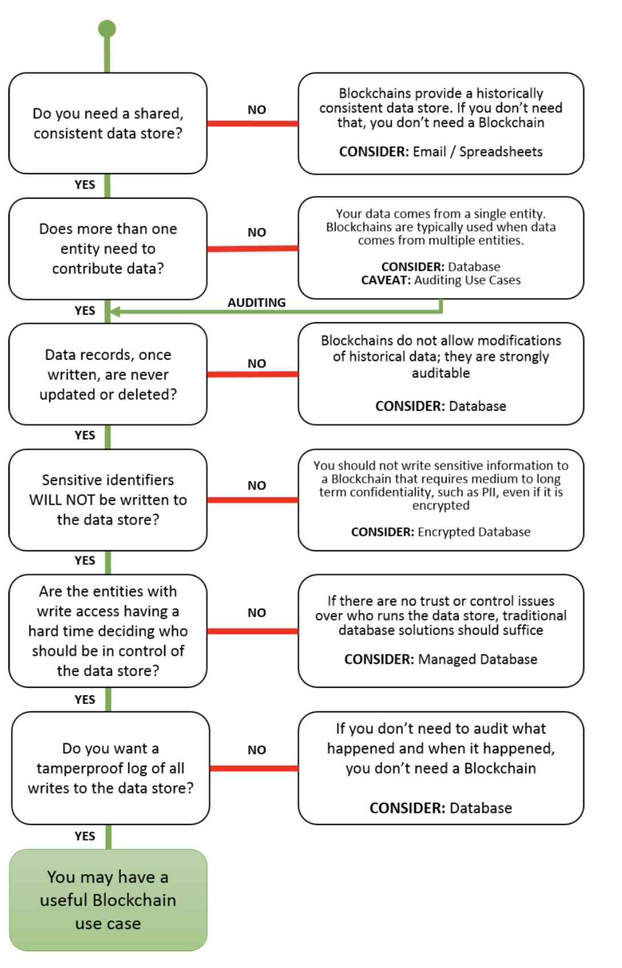
The Blockchain Game
Notes:
-Distribute Ledger
-Distribute
—-then hash
—-then voting

Slide 35
Review
Distributed Ledger
  No central authority to hold ledger or be attacked.
  All people (aka nodes) have complete ledger.
Transparent but anonymous Ledger
  Ledger can be public while concealing identity.
Append only Ledger
  Each entry (aka block) is linked to the previous entry via some math (aka hash)
  Some node (aka miners) are paid for performing calculations (aka proof of work)
Immutable Ledger
  Attacks to ledger are impractical due to need for majority of nodes to agree to a change and the computational power required.

Slide 36
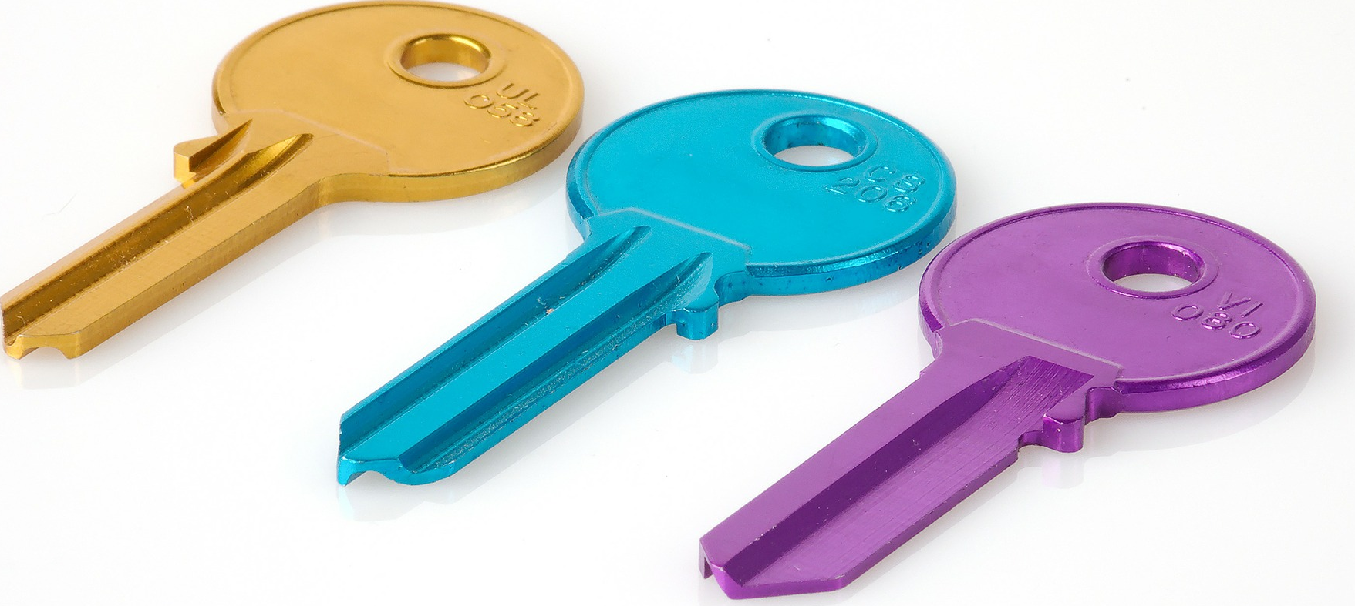
Blockchain FYI
Mid-Missouri Chapter of Internal Auditors
Public Key Encryption is an Essential Part of Blockchain

Slide 37
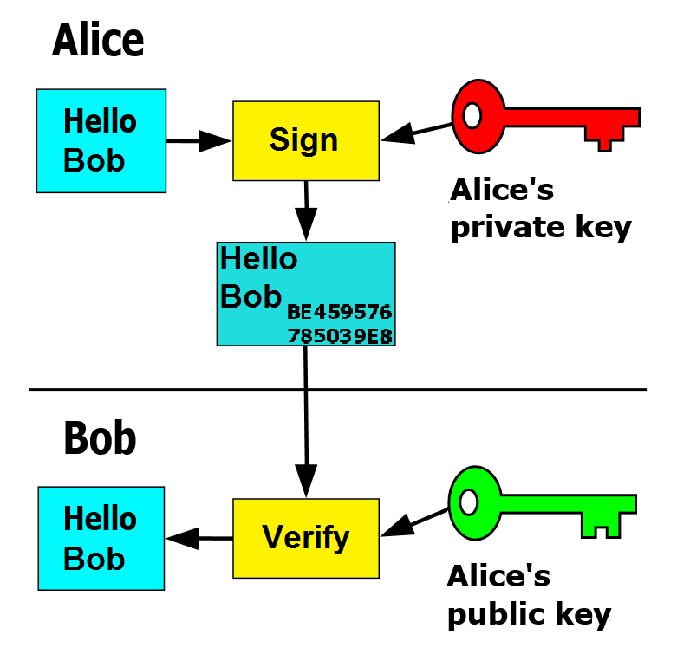
Blockchain FYI
Mid-Missouri Chapter of Internal Auditors
Public Key Encryption is also used to digitally sign transactions
Notes:
Give Bitcoin

Slide 38
Photo and Graphics Credits
All Graphics and photos are either self created or creative commons 0 (public domain). Most are from pixabay.com

